Slide 1
COVID & telecommuting-induced changes in individual activity and travel patterns
2025 Modeling Mobility Conference
Brian H. Y. Lee, Ph.D. 15 Sep 2025

Slide 2

Overview & reference paper
Introduction
Data & methodology
Results
Conclusions
Transport Policy paper
COVID & telecommuting-induced changes in individual activity and travel patterns: Evidence from the Puget Sound Region
By Grace Jia, Kaitlyn Ng, Ekin Ugurel, Brian Lee, Ram Pendyala, Cynthia Chen
Transport Policy paper
(free access before 28 Oct 2025)

Slide 3
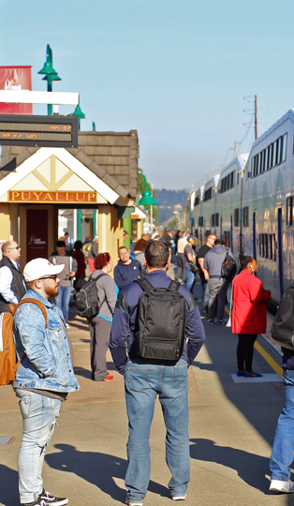
Introduction
Big picture question:
How does telecommuting change people’s daily activity & travel patterns?

Slide 4
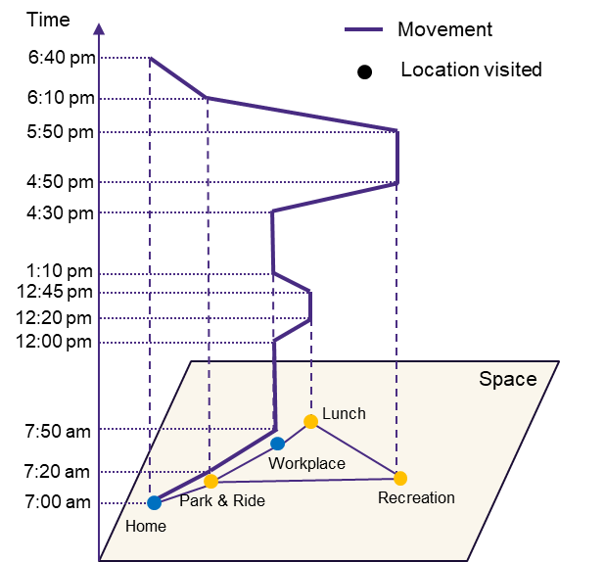
Introduction
Locations
Anchors: home & workplace
Maintenance/discretionary: restaurants, banks, shops
Trips
Mandatory: connect anchors
Maintenance: grocery shopping, dry cleaning
Discretionary: visit friends, recreation
Hypothesized movements of a person using Hägerstrand’s space-time prism framework

Slide 5

Introduction
With workplace as an anchor point removed, how do people reschedule their activities and modify their travels?
Hypothesized movements of a person using Hägerstrand’s space-time prism framework

Slide 6
Introduction
Research questions:
Trip generation
Fewer or more overall?
Maintenance vs. discretionary?
Simpler or more complex?
Activity/travel redistribution
Cluster more around home?
Shift in time of day?
Modes & amount of travel
Less or more vehicle-based?
Lower or higher VMT?
Hypothesized movements of a person using Hägerstrand’s space-time prism framework

Slide 7

Data & methodology
Puget Sound Regional Council (PSRC) Household Travel Survey (HTS) data
Representative data for four-county Seattle metropolitan region
Revealed preference of activity & travel choices for residents every two years
Three waves used for analyses
2017 & 2019 (pre-pandemic)
2021 (COVID era)
PSRC HTS data

Slide 8
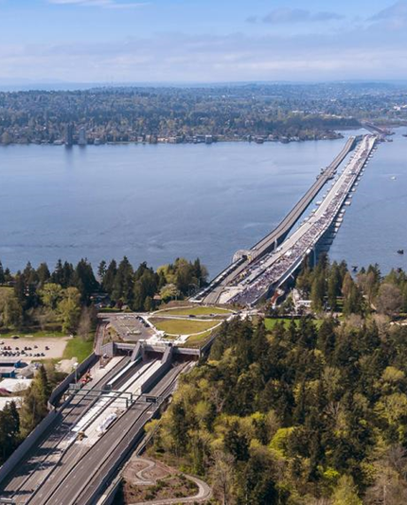
Data & methodology
COVID pandemic: biggest natural experiment in history for studying telecommuting
Quasi-experimental design
2017/2019: identified Commuters (control group)
> Work from home (WFH) policies = treatment <
2021: identified Telecommuters¹ (treatment group)
Two groups matched on characteristics (covariates) found in literature that relate to telecommuting
Age, income, household size
Population density, access to jobs & amenities
¹ Telecommuters = workers who WFH at least one day per week

Slide 9
Data & methodology
Propensity score matching
Statistical technique used to estimate casual effect when treatment not randomly assigned
Treatment = WFH, workplace no longer anchor
Each telecommuter matched with its “closest” commuter based on the propensity scores²
Quality check: compared two groups’ covariates
Defined outcome evaluation metrics
Trip generation
Spatial & temporal redistribution
Mode & VMT changes
² Probabilities of belonging to telecommuter sample, calculated from logistic regression

Slide 10
Results – Trip generation
Telecommuters made fewer overall trips, but more non-mandatory trips and more simple trip chains
Substitution between work & non-mandatory trips is inelastic; X% decrease in work trips ➔ >X% increase in non-mandatory trips
Metrics (per person per day) | Commuters (n=936) | Telecommuters (n=950) | Effect size
Overall trips | 3.94 | 3.37 | 0.27 (-)*
Maintenance trips | 1.30 | 1.50 | 0.11*
Discretionary trips | 1.13 | 1.38 | 0.16*
Stops per trip chain | 1.93 | 1.57 | 0.27 (-)*
* Statistically significant at p = 0.05; (-) means telecommuting decreases metric

Slide 11
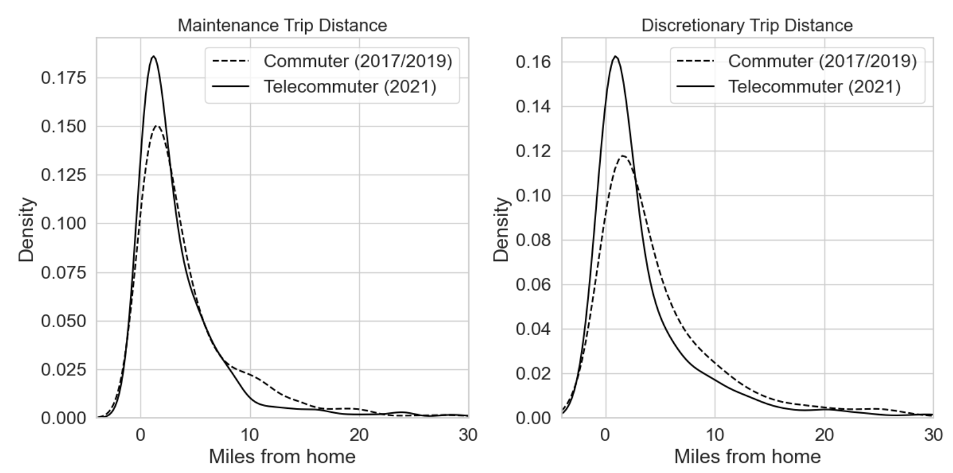
Results – Spatial redistribution
Telecommuters made non-mandatory trips closer to home

Slide 12
Results – Spatial redistribution
Telecommuters had smaller footprint around home (radius of gyration), and closer non-mandatory destinations from home
Telecommuters traveled less via all modes
Metrics (miles) | Commuters (n=936) | Telecommuters (n=950) | Effect size
Radius of gyration | 4.77 | 3.00 | 0.34 (-)*
Average distance from home for maintenance destinations | 3.91 | 3.07 | 0.19 (-)*
Average distance from home for discretionary destinations | 4.68 | 3.24 | 0.25 (-)*
Total distance traveled for maintenance trips | 15.1 | 11.7 | 0.23 (-)*
Total distance traveled for discretionary trips | 12.2 | 9.69 | 0.18 (-)*
* Statistically significant at p = 0.05; (-) means telecommuting decreases metric

Slide 13
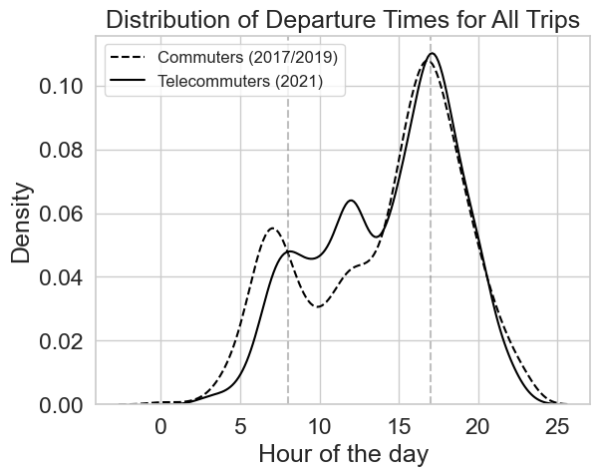
Results – Temporal redistribution
Telecommuters traveled more during mid-day than in morning peak

Slide 14
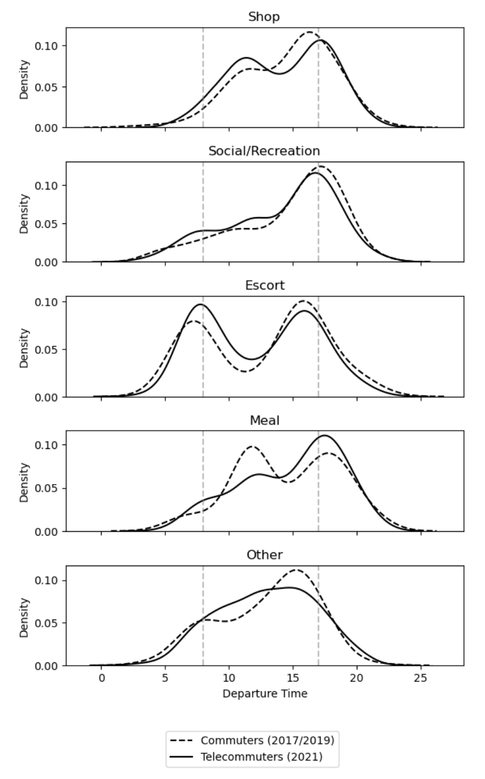
Results – Temporal redistribution
Shopping & social trips more spread throughout day
Escort trips remain constrained
Telecommuters made fewer lunch trips
Personal businesses & medical trips (84% of other) more often rescheduled during mid-day

Slide 15
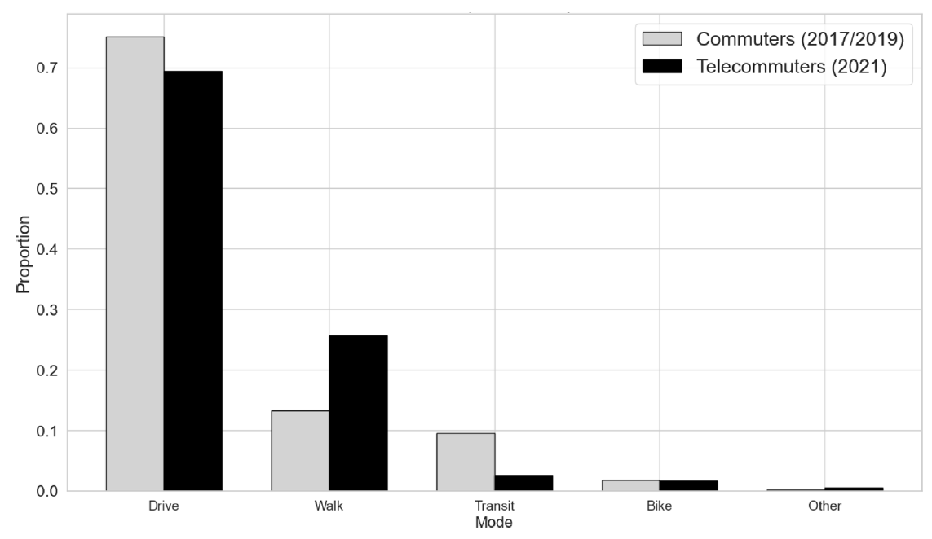
Results – Mode
Telecommuters still favored driving, walked more, & used transit less

Slide 16
Results – Vehicle miles traveled (VMT)
Telecommuters travelled significantly fewer miles via car for non-mandatory trips
Metrics (miles) | Commuters (n=936) | Telecommuters (n=950) | Effect size
Total VMT for maintenance trips | 15.1 | 11.7 | 0.23 (-)*
Total VMT for discretionary trips | 9.97 | 8.25 | 0.18 (-)*
* Statistically significant at p = 0.05; (-) means telecommuting decreases metric

Slide 17
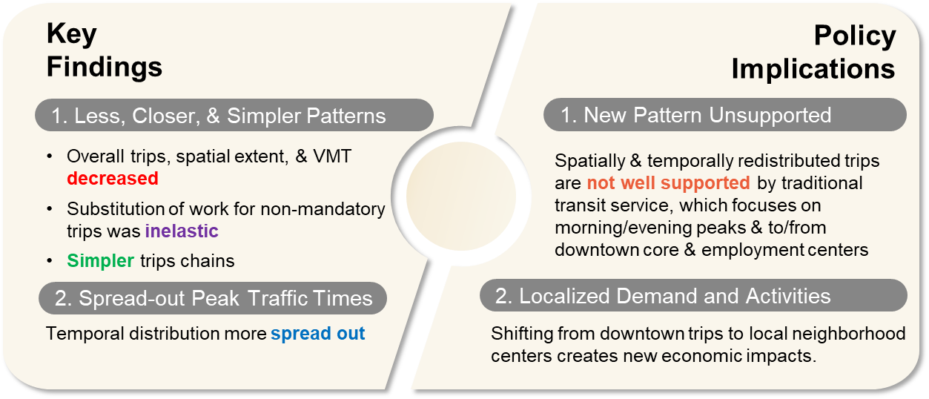
Conclusions

Slide 18
Thank You!
Brian H. Y. Lee, Ph.D.
Program Manager, Data Solutions & Research
blee@psrc.org
Transport Policy paper
PSRC HTS
data
(free access before 28 Oct 2025)

